Slide 1

Business Analytics: Methods, Models, and Decisions
Third Edition
Chapter A1
Basic Excel Skills
Copyright © 2020, 2016, 2013 Pearson Education, Inc. All Rights Reserved
Notes:
If this PowerPoint presentation contains mathematical equations, you may need to check that your computer has the following installed:
1) MathType Plugin
2) Math Player (free versions available)
3) NVDA Reader (free versions available)

Slide 2
Basic Excel Skills
Opening, saving, and printing files
Using workbooks and worksheets
Moving around a spreadsheet
Selecting cells and ranges
Inserting/deleting rows and columns
Entering and editing text, data, and formulas
Formatting data (number, currency, decimal)
Working with text strings
Formatting data and text
Modifying the appearance of a spreadsheet

Slide 3
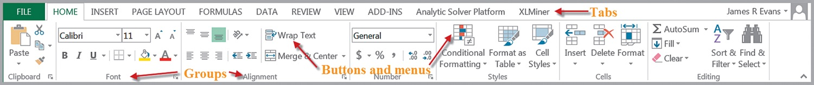
Excel 2016 Ribbons
Windows
Mac

Slide 4
Excel Add-Ins
Analysis Toolpak (Data Analysis), which contains a variety of tools for statistical computation
Solver, which is used for optimization
If they do not appear in the Data tab, see the instructions in Appendix A1.

Slide 5
Excel Formulas
Common mathematical operators are used.
addition (+)
subtraction (−)
multiplication (*)
division
exponentiation

Slide 6
Relative and Absolute References
Cell references can be relative or absolute. Using a dollar sign before a row and/or column label creates an absolute reference.
Relative references: A2, C5, D10
Absolute references: $A$2, $C5, D$10
Using a $ sign before a row label (for example, B$4) keeps the reference fixed to row 4 but allows the column reference to change if the formula is copied to another cell.
Using a $ sign before a column label (for example, $B4) keeps the reference to column B fixed but allows the row reference to change.
Using a $ sign before both the row and column labels (for example, $B$4) keeps the reference to cell B4 fixed no matter where the formula is copied.

Slide 7
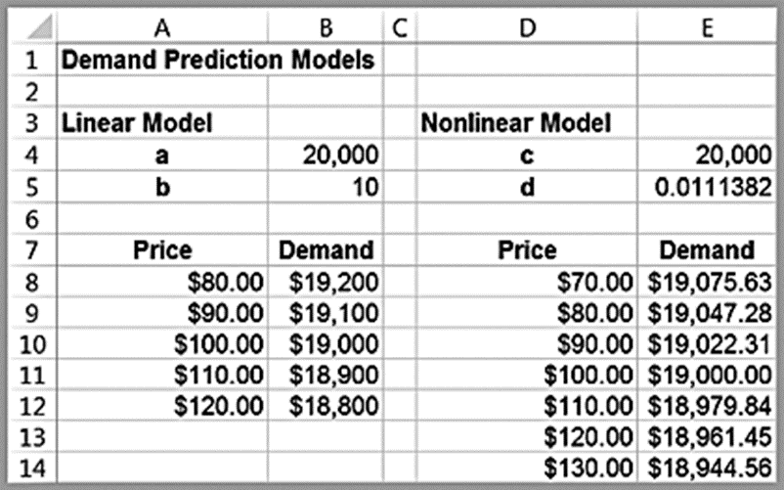
Example A1.1: Implementing Price-Demand Models in Excel
Two models for predicting demand as a function of price Linear
Formula in cell B8:
Nonlinear
Formula in cell E8:
Note how the absolute addresses are used so that as these formulas are copied down, the demand is computed correctly.

Slide 8
Copying Formulas
Formulas in cells can be copied in many ways.
Use the Copy button in the Home tab, then use the Paste button
Use
Drag the bottom right corner of a cell (the fill handle) across a row or column

Slide 9
Other Useful Excel Tips
Split Screen
Column and Row Widths
Displaying Formulas in Worksheets
Displaying Grid Lines and Column Headers for Printing
Filling a Range with a Series of Numbers

Slide 10
Basic Excel Functions
Excel has other useful COUNT-type functions: COUNTA counts the number of nonblank cells in a range, and COUNTBLANK counts the number of blank cells in a range. In addition,
finds the number of cells within multiple ranges that meet specific criteria for each range.

Slide 11
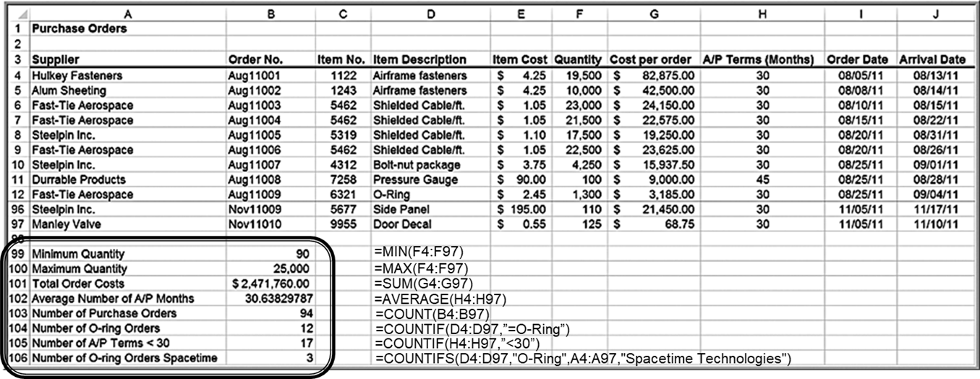
Example A1.2: Using Basic Excel Functions

Slide 12
Other IF-Type Functions
SUM IF, AVERAGE IF, SUM IFS, and AVERAGE IFS can be used to embed IF logic within mathematical functions.
For instance, the syntax of SUM IF is
“Sum range” is
an optional argument that allows you to add cells in a different range.

Slide 13
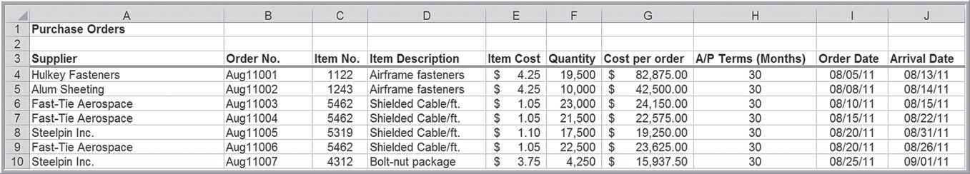
SUMIF Example
In the Purchase Orders database, to find the total cost of all airframe fasteners, use

Slide 14
Functions for Specific Applications
Net Present Value (or discounted cash flow) measures the worth of a stream of cash flows, taking into account the time value of money.
Excel function:
F is the cash flow ($).
Rate (i) is the discount rate.
are equally-spaced payments or
income values.
t is a time period.

Slide 15
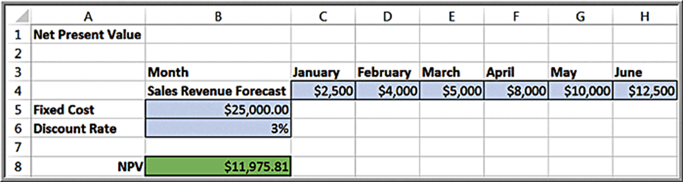
Example A1.3: Using the N P V Function
Cell B8:

Slide 16
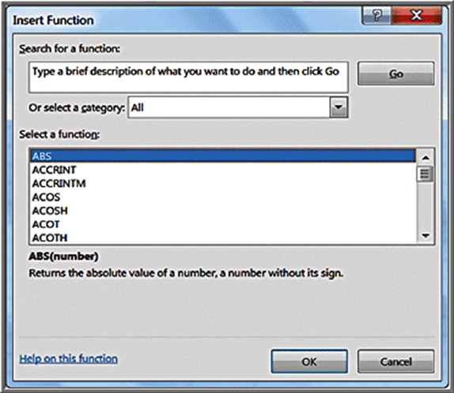
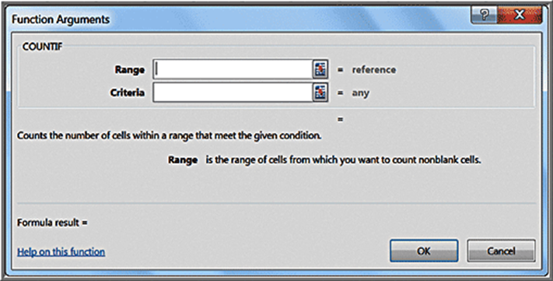
Insert Function
Click the Insert
function button
You may type in a description or search.
Example for COUNT IF function:

Slide 17
Date and Time Functions
Excel can display a date in a variety of formats, such
Choose the standard date
format
by selecting Date in
the Number formatting box or select a custom format by selecting Custom in the Number box.
Time unit can be “y”, “m”, or “d”.
will return 27
(years), while
will return 333 (months).

Slide 18
Range Names
A range name is a descriptive label assigned to a cell or range of cells. There are several ways to create range names in Excel.
Name box
Create from Selection
Define Name

Slide 19
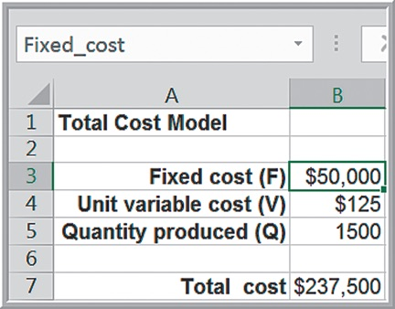
Example A1.5: Using the Name Box
Define range names for each of the numerical cells that correspond to the labels on the left. That is, we will name cell B3 Fixed cost, cell B4 Unit variable cost, and so on. Click on cell B3; in the Name box,
type the name
(note the underscore;
blanks are not permitted), and then press Enter.

Slide 20
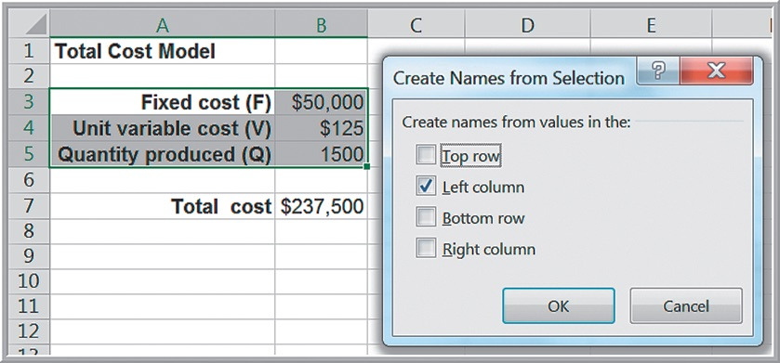
Example A1.6: Using Create from Selection
Use the text labels to the left of the numerical inputs as the range names. First, highlight the
range
Then, on the Formulas tab, choose
Create from Selection. The box for the left column will automatically be checked. Click OK.

Slide 21
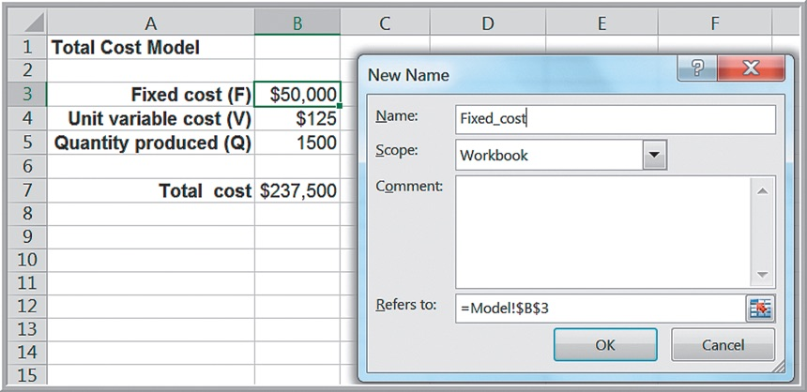
Example A1.7: Using Define Name
Select cell B3. Click Define Name on the Formulas tab. This will bring up a dialog that allows you to enter a range name. Click OK.

Slide 22
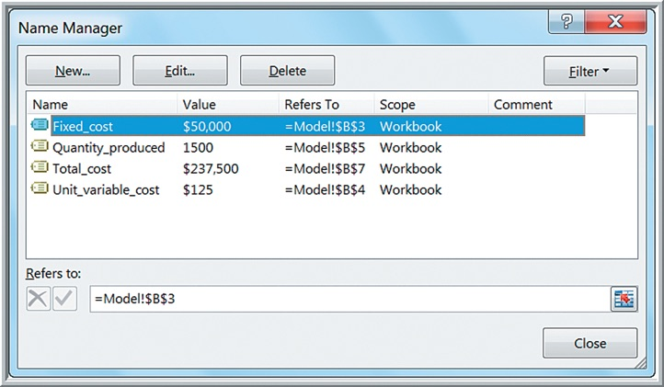
Name Manager
Displays a summary of range names for editing. (Note: The Name Manager button in the Formulas tab is only available in Windows. On a Mac, click Define Name to see a list of range names.)

Slide 23
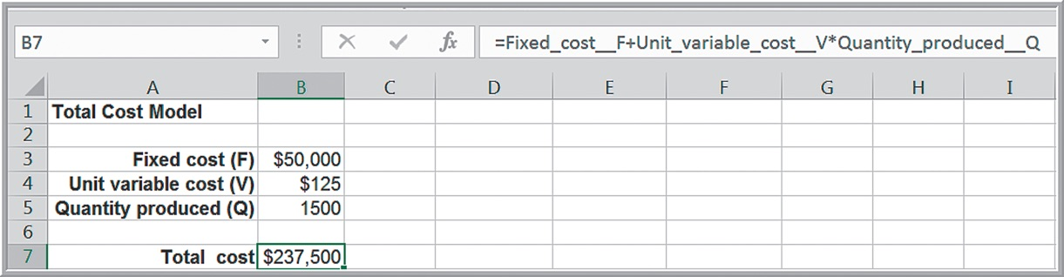
Applying Range Names
This replaces the cell references by the names. Click on the drop-down arrow next to Define Name and select
Select all the names you wish to use
and click OK. In the figure, the original formula for
cell
now displays the names.

Slide 24
VALUE Function
It’s not unusual to download data from the Web that looks numerical but is actually expressed as text; this is often true of data from U.S. government Web sites.
converts text data to numerical values.

Slide 25
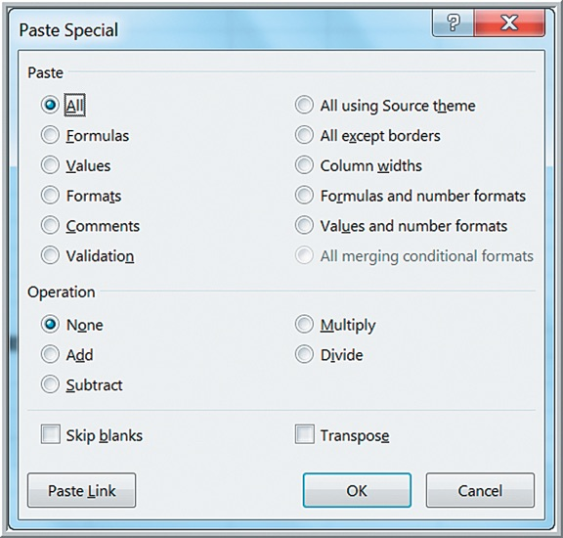
Paste Special
Copy the range of cells of interest and click on the cell where you want to paste the results. Examples:
To paste only the values in cells (not the formulas), select Values and then click OK.
To transpose data in columns to rows and vice versa, use Transpose.

Slide 26
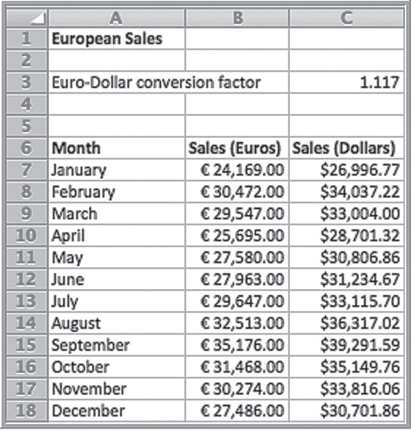
Example A1.8: Currency Conversion
Assume that 1 euro = $1.117. To convert euros into U.S. dollars, first copy the data to column C. Select cell C3 corresponding to the conversion factor. Next, select the range of data in column C and open the Paste Special dialog. Select Multiply.

Slide 27
Concatenation
To concatenate means to join. In many applications, you might wish to take text data that are in different columns and join them together (for example, first and last names). The Excel function
used to join up to 30 text strings into a single string.
Suppose that cell A1 contains the last name Smith, and cell B1 contains the first name John. Then
will result in the text
string John Smith.

Slide 28
Error Values
-A formula is trying to divide by zero.
-“Not available,” meaning that the formula could not return
a result.
-An invalid name is used in a formula.
-An invalid argument is used in a function, such as a negative
number in SQRT.
-A formula contains an invalid cell reference.
-Excel cannot compute a function because of an invalid
argument.

Slide 29
IFERROR Function
displays a
specific value if an error is present.
For example, if you are computing
then if
B1 is zero or blank, then
will display a blank cell instead of

